Slide 1
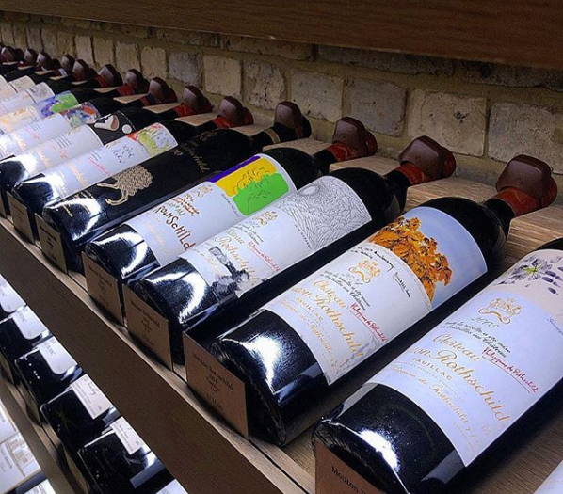
Melissa Morgan
Blake Skinner
Godwin Thomas
Julia Thompson
Rebekah Vinson

Slide 2
the vino, the grape, plonk, vin du pays, port, burgundy, vin de table, vin ordinaire, walla walla, splishy splashy, slap the belly
Why Wine?

Slide 3
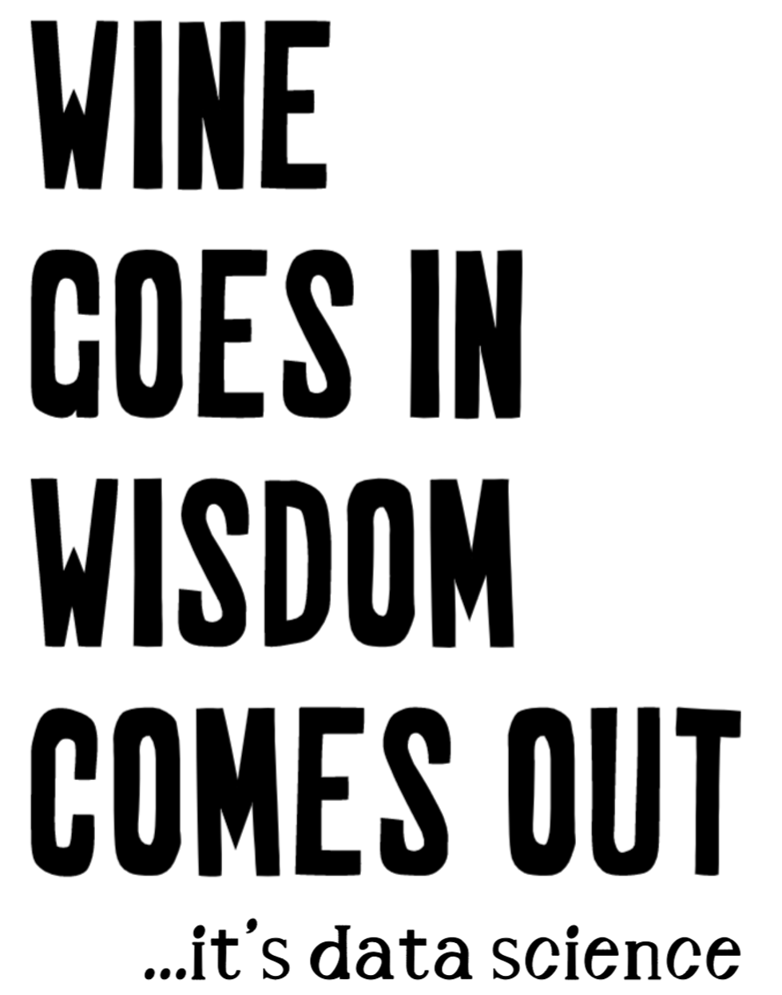
the answer…

Slide 4
the Data Dorks can help out the Cork Dorks

Slide 5
The Effect of Physicochemical on the Wine Quality

Slide 6

THE SOURCE
Paulo Cortez, University of Minho,
Guimarães, Portugal
THE DATA
Our two datasets include:
A list of approximately 1,600 red wines
A list of approximately 4,800 white wines
OBJECTIVE
Develop a machine learning model using the chemical makeup of wine to predict its quality.

Slide 7
Attributes
Input variables (based on physicochemical tests):
1 - fixed acidity
2 - volatile acidity
3 - citric acid
4 - residual sugar
5 - chlorides
6 - free sulfur dioxide
7 - total sulfur dioxide
8 - density
9 - pH
10 - sulphates
11 - alcohol
Output variable (based on sensory data):
12 - quality (score between 0 and 10)

Slide 8
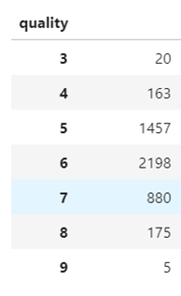
The Models
Pulled in data from a csv (red and white were separate)
Looked at the datatypes, all were float except for quality so changed datatype to float for quality
Looked at data shape, quality is not evenly distributed amongst classifications. Skewed heavily to quality of 5/6. Understand that this is heavily going to affect our model

Slide 9
The Models
Model | Accuracy
RandomForestClassifier | 0.707142857
XGBoost | 0.66122449
DecisionTreeClassifier | 0.582653061
KNeighborsClassifier | 0.558035714
LogisticRegression | 0.481632653
NaivesBayes | 0.448341837
Created x and y variables – quality is our output (y) and the other features are the x
Train test split from x and y variables
Run the following models and got the following accuracies – linear regression r2 score = 0.281361

Slide 10
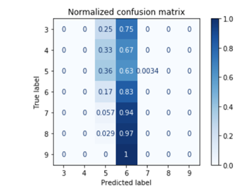
The Models
Tried two different types of data scaling – feature scaling and PCA. Neither helped the shape of our data enough to impact our model.
Tried two different types of hypertuning to improve our accuracy. Randomized Search & GridSearch. When the optimal params from those searches were added to the model our accuracy decreased.
Used pickle to save our model down into a callable sav file
confusion matrixes to see where there were inaccuracies - shows that model chose 6 far too often

Slide 11
Live demo time
bc633.pythonanywhere.com

Slide 12
Data Science Happens… Wine helps
ANY QUESTIONS?

